Slide 1

ENPM 691 Project Finding vulnerabilities in Audacity application
-Reitwick Prakash
-Abhay Khattar
-Pridhvi Krishna Meduri

Slide 2
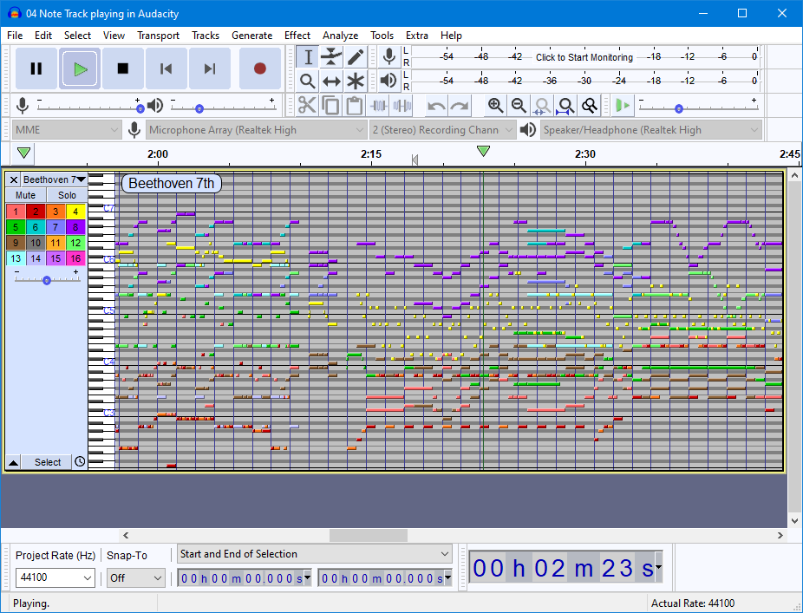
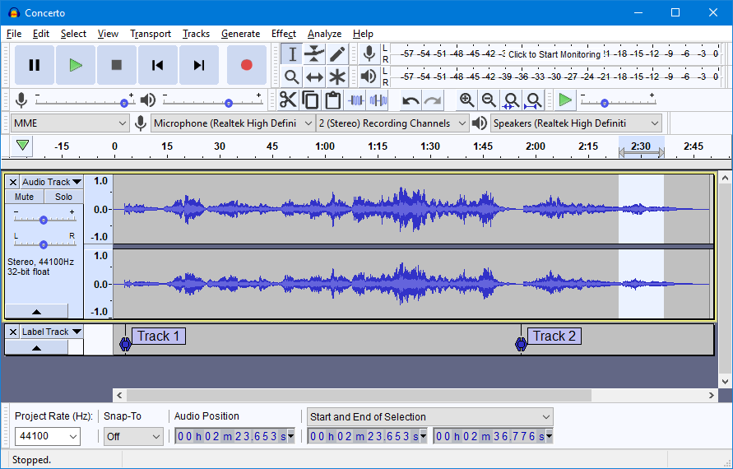
Audacity Introduction
Audacity is an easy-to-use, multi-track audio editor and recorder for Windows, macOS, GNU/Linux and other operating systems.
Developed by a group of volunteers as open source.

Slide 3
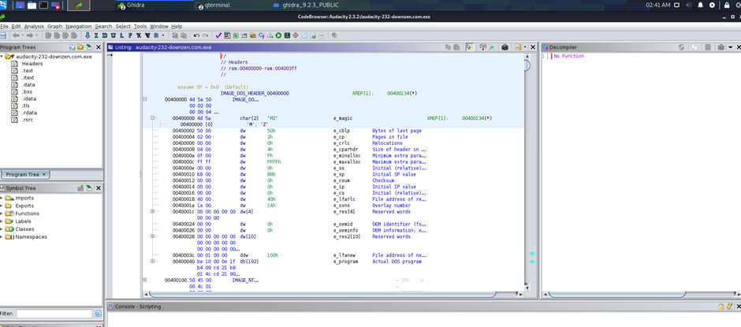
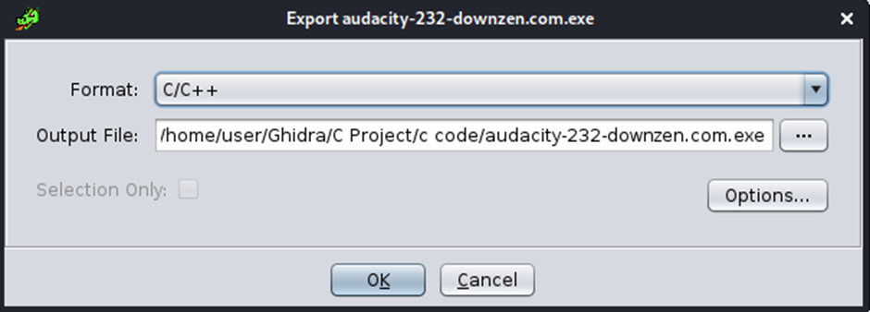
Ghidra
Open source and developed by National Security Agency of USA.
It contains Software Engineering Tools.
We used it for exporting C code from the Audacity.exe file.
This helped us analyse the code in a more efficient way.

Slide 4
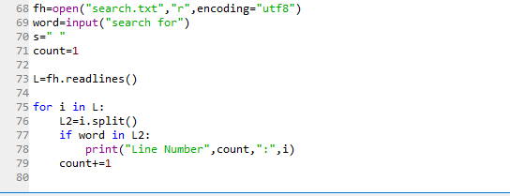
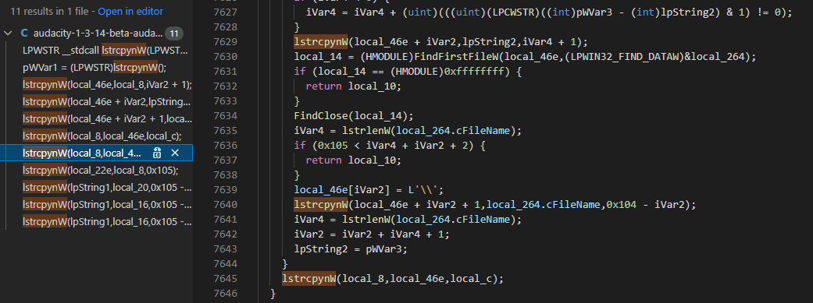
Finding Banned function
Used python to search for banned functions.
Found “lstrcpynW” being used multiple times in the code.
lstrcpynW( LPWSTR lpString1,
LPCWSTR lpString2, int iMaxLength);

Slide 5
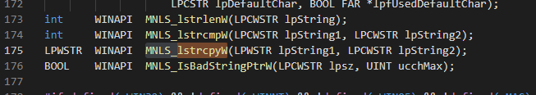
Using Visual Studio Code
About
Found use of another banned function ‘MNLS_lstrcpyW’.
File-mapinls.h
Line Number-175

Slide 6
Why were the above methods not successful?
On further Analysis-
Since we decompiled the code using Ghidra. It took symbols from the whole Audacity, including libraries it links to but have become redundant now.
lstrcpyW- It is not being used in the Audacity Code as it is part of Win32 API.

Slide 7
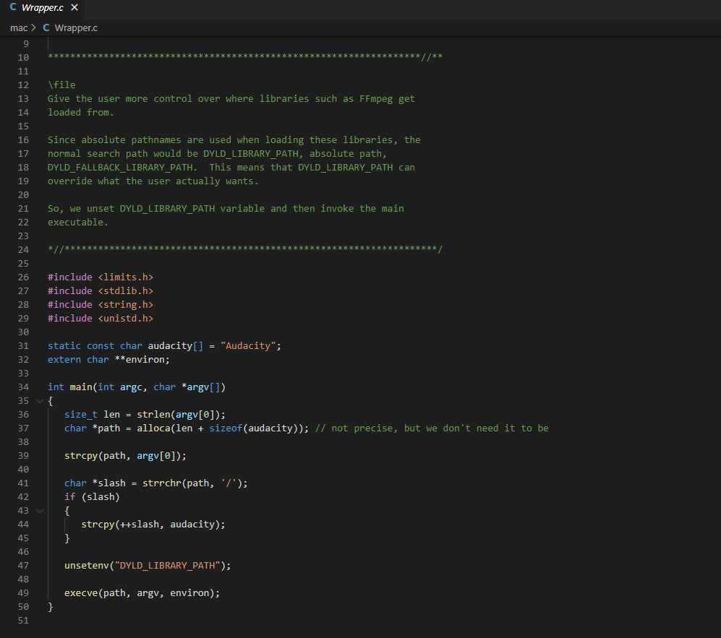
Wrapper.c

Slide 8
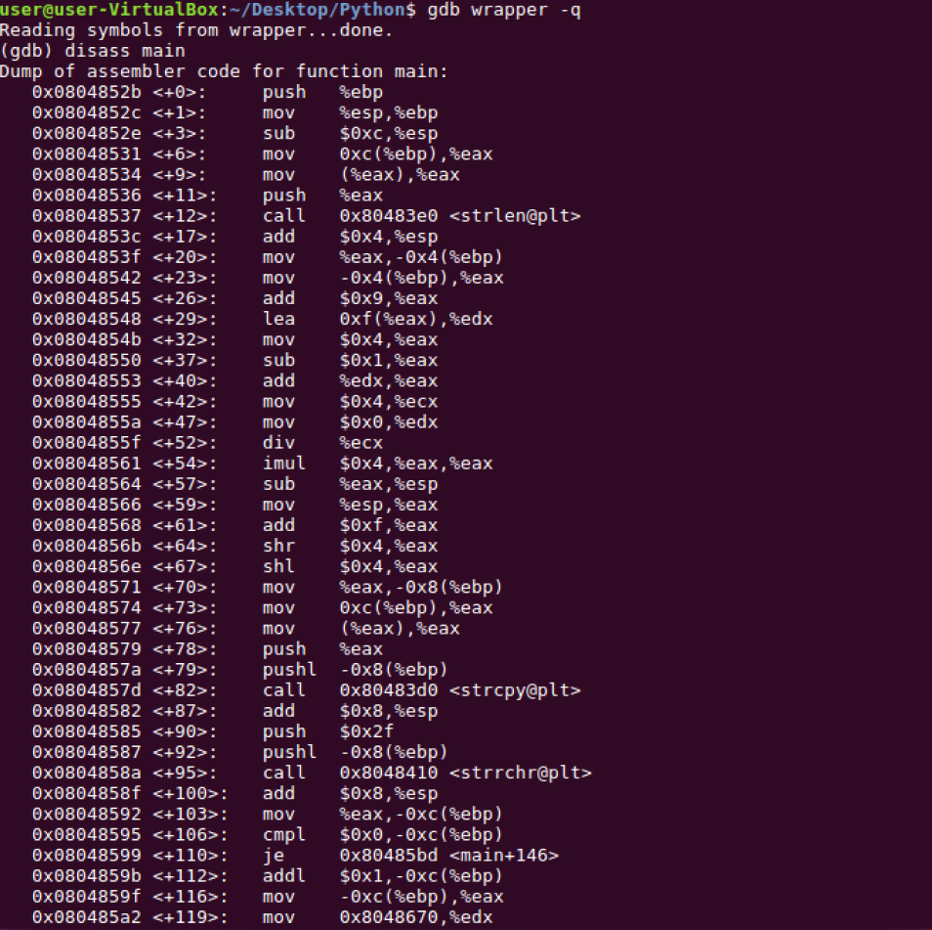
Analysis on use of strcpy-
Strcpy- which is a banned function as well is being used multiple times inside the code.
We used one such instance of the code and tried to perform various vulnerabilities we learnt till now.

Slide 9
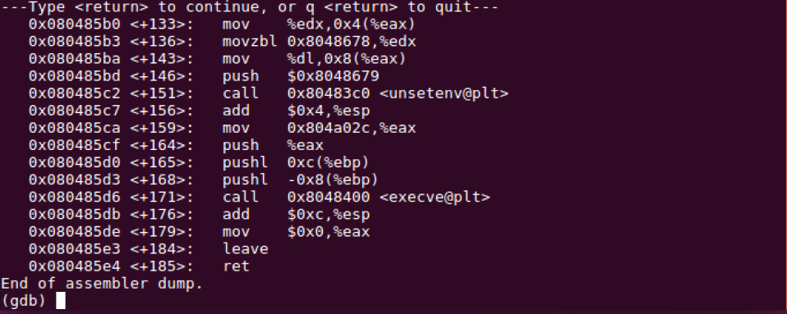

Slide 10
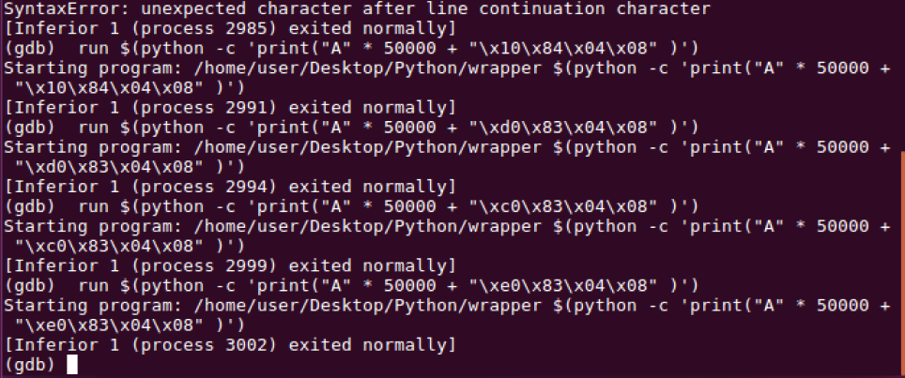
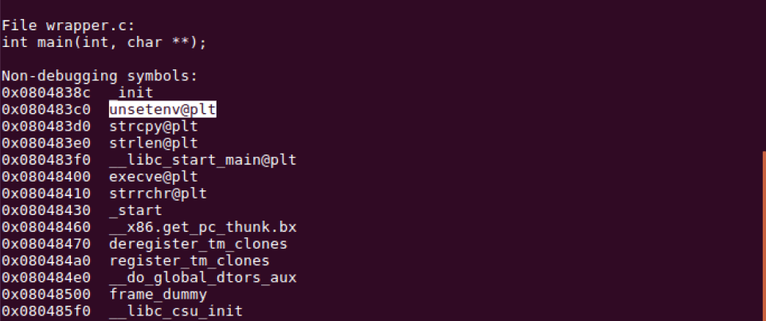

Slide 11
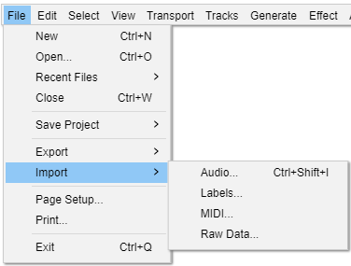
Imports in Audacity The audio formats importable by Audacity with the File > Import

Slide 12
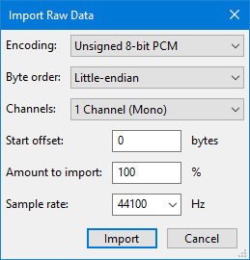
Imports in Audacity (Contd.)
Audio: Will launch a file selection window. User can choose if the user wants to import one or more audio files and these files would be added as new tracks.
Labels: Will launch a file selection window. User can choose if the user wants to import a single text file or multiple project labels.
MIDI: Will launch a file selection window. User can choose if the user wants to import a MIDI or Allegro (GRO) file.
RAW Data: Will launch a file selection window. User can choose if the user wants to import an uncompressed audio file that might be "raw" data without any headers.

Slide 13
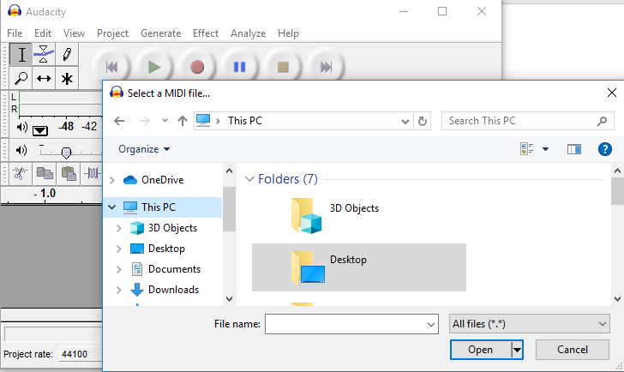
Buffer Overflow in Import MIDI
Analysing exploit in immunity debugger:
Run Audacity
Go to File > Import > MIDI

Slide 14
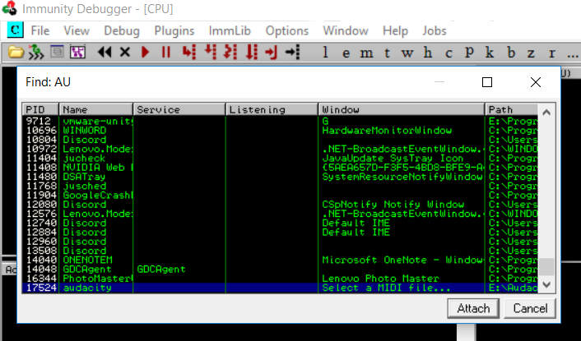
Debugger
Open Immunity Debugger as Administrator
File >> Attach Audacity

Slide 15
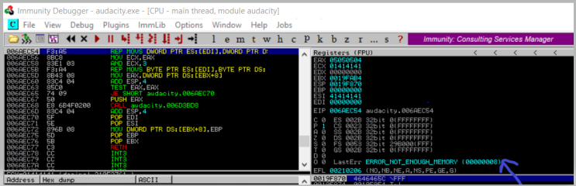
After attaching audacity. Press F9 (To Run) on immunity debugger. This is required, otherwise we wont be able to add our (Allegro extension).gro exploit to audacity.

Slide 16
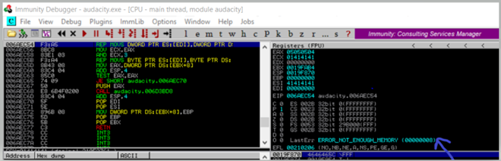
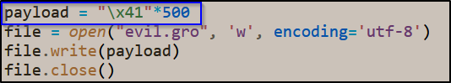
Proof of Concept

Slide 17
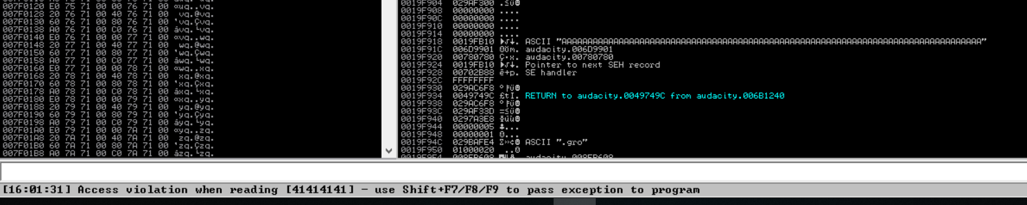
Shift+f9

Slide 18
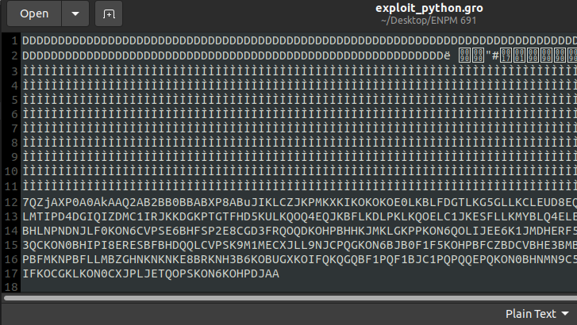
Exploit Creation

Slide 19
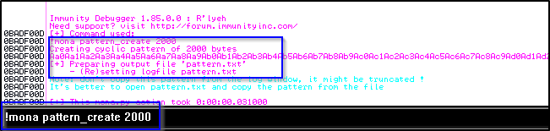
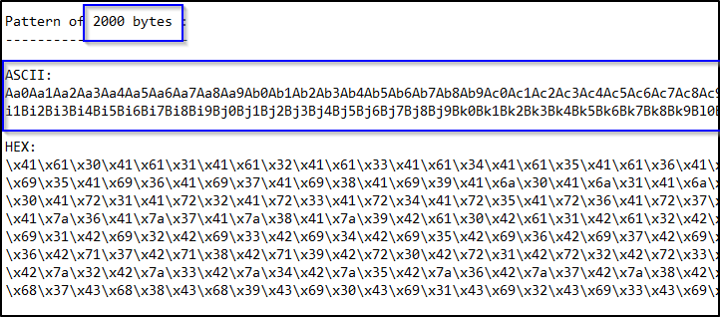
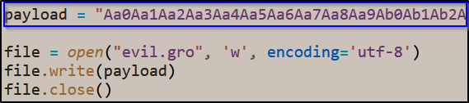
Pattern Creation

Slide 20
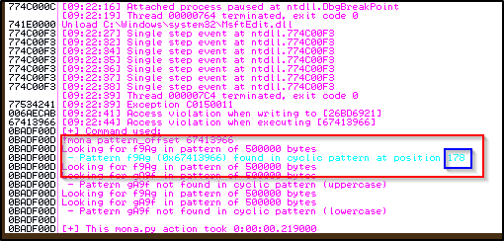
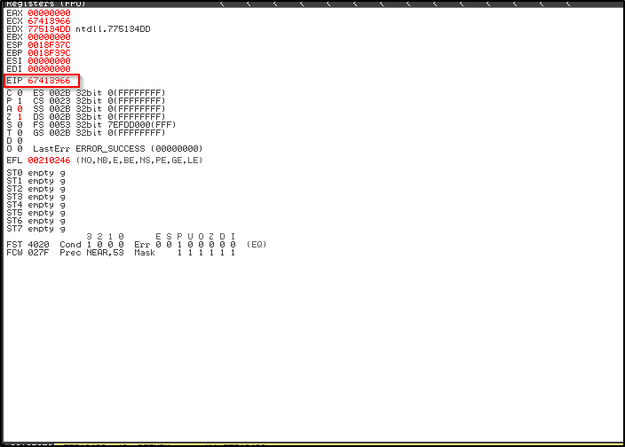
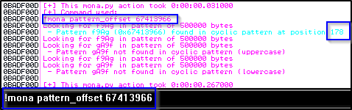
Finding Offset

Slide 21
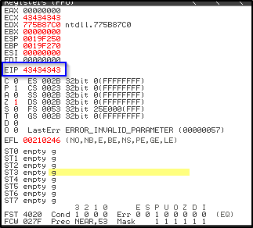
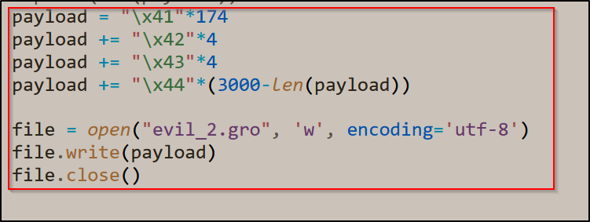
Payload file creation in python

Slide 22
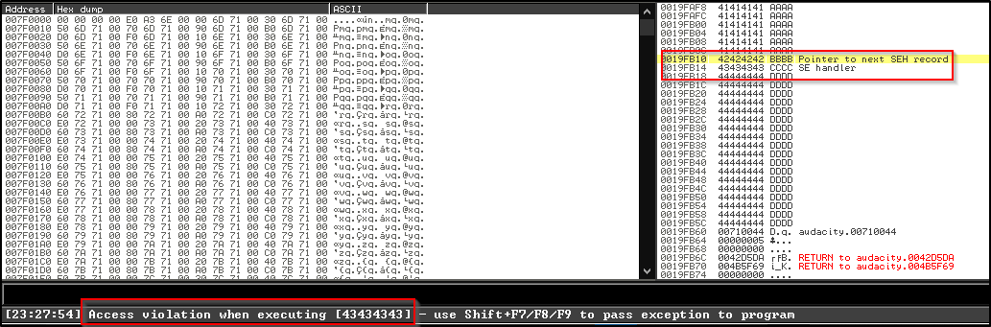
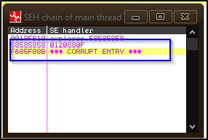
STRUCTURED EXCEPTION HANDLER

Slide 23
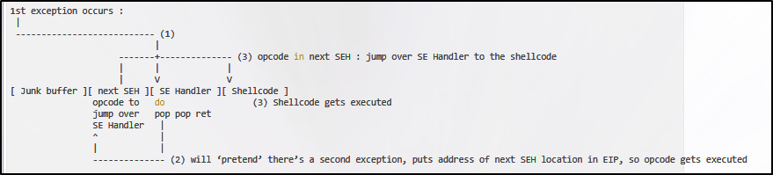
Exploiting SEH based Vulnerability
Image Source - https://www.corelan.be/index.php/2009/07/25/writing-buffer-overflow-exploits-a-quick-and-basic-tutorial-part-3-seh/

Slide 24
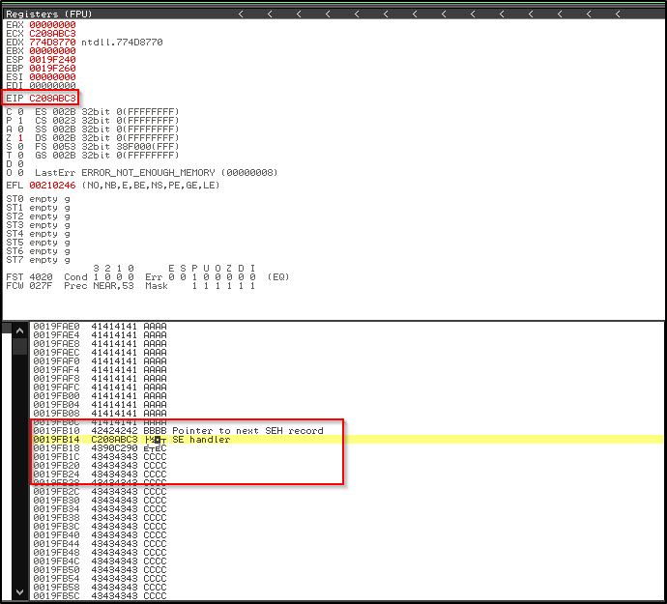
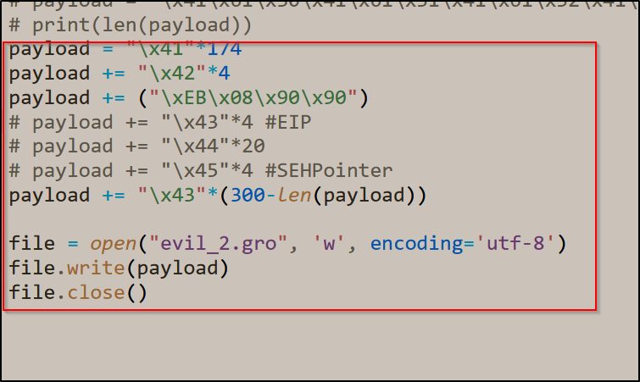
Using Short Jump

Slide 25
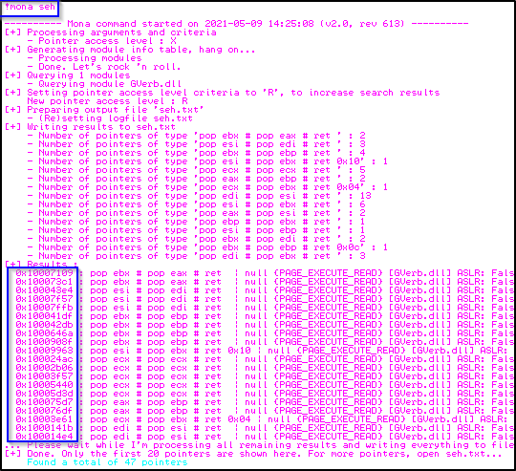
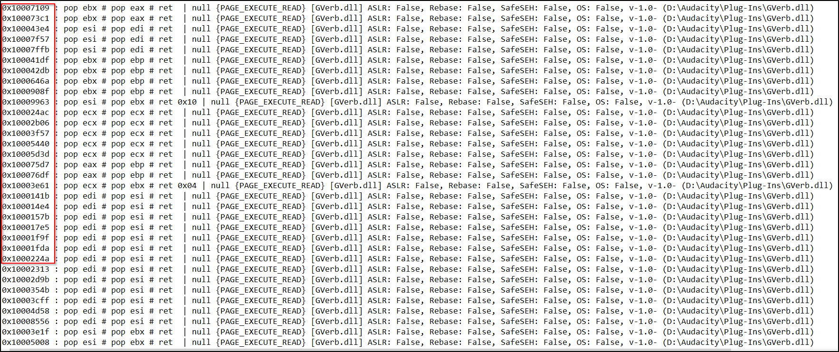
Finding Pop-Pop-Ret Sequences

Slide 26
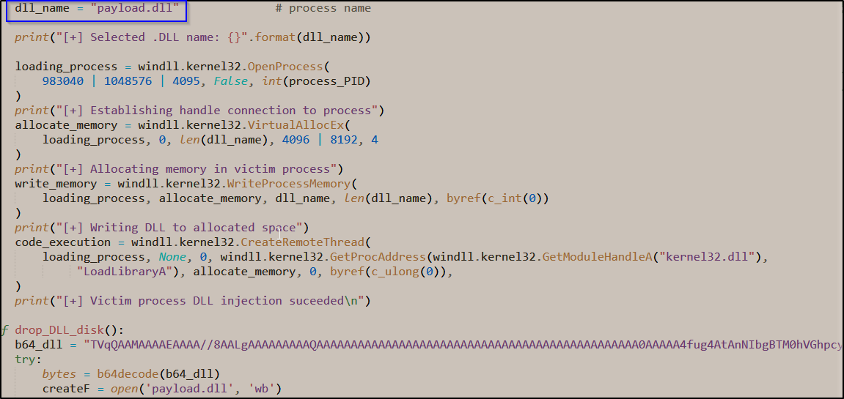
DLL Injection

Slide 27
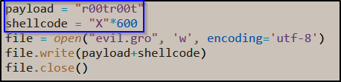
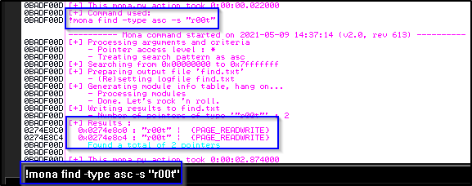
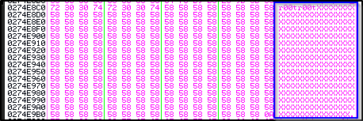
Using an EggHunter

Slide 28
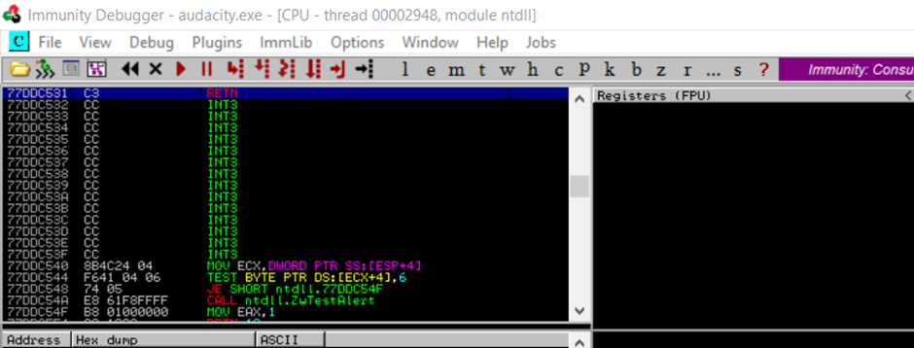
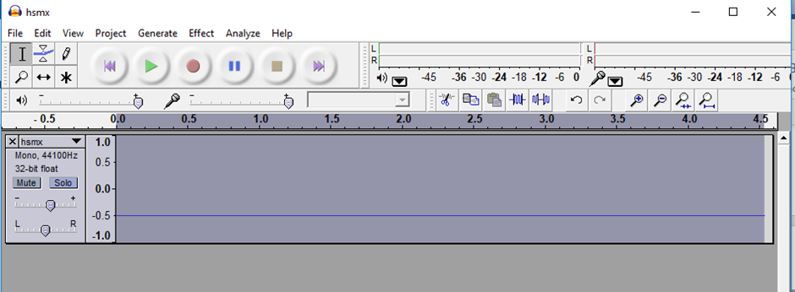
Tried this exploit with other input formats as well. But this did not work. Got the same O/P.
Hsmx.txt- In raw, In label

Slide 29
References
https://www.exploit-db.com/exploits/7634
https://github.com/audacity/audacity
https://ghidra-sre.org/
https://code.visualstudio.com/
https://www.corelan.be/index.php/2009/07/19/
https://iphelix.medium.com/getting-from-seh-to-nseh-5b9bdb481c72
https://www.corelan.be/index.php/2009/07/25/writing-buffer-overflow-exploits-a-quick-and-basic-tutorial-part-3-seh/

